Slide 1
Unit 1:
Nature Of Science
Chapter 1.3: Measurement, pg 14-20
Chapter 1.4: Presenting Scientific Data, pg 22-25
Chapter 1.2: Using a Scientific Approach, pg 7-11

Slide 2
Progression of Objectives 1 & 2
Accuracy and Precision
Random and Systematic Errors
Significant figures
  Counting sig figs
  Calculating with sig figs
Measurement
  Base Units
  Prefixes
  Writing measurement
    Number
    Uncertainty
    Units

Slide 3
Nature of Science
Pure science aims to come to a common understanding of the universe…
Scientists suspend judgment until they have a good reason to believe a claim to be true or false…
Evidence can be obtained by observation or experimentation…
  Observations followed by analysis and deduction…inference…(pic)
  Experimentation in a controlled environment…
Notes:
Pink Packet Day 1 Notes & Discussion
THEN GO TO SLIDE 6 regarding EVIDENCE…

Slide 4
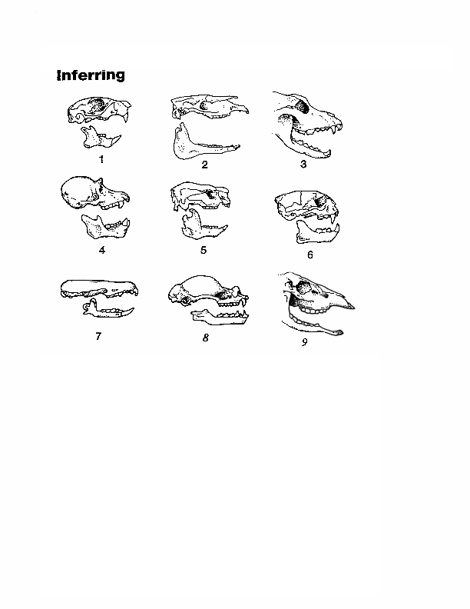
Observations vs. Inferences 1

Slide 5
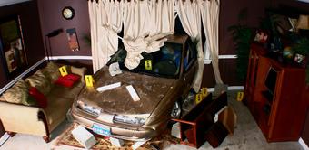
Observations vs. Inferences 2

Slide 6
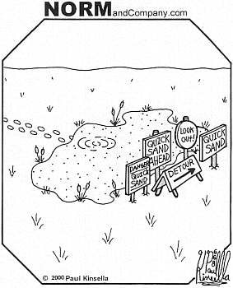
Observations vs. Inferences 3
Notes:
GO BACK TO SLIDE 2

Slide 7
Purpose of Evidence
Evidence is used to develop theories, generalize data to form laws, and propose hypotheses.
Theory –well-tested explanation of things or events based on knowledge gained from many observations and investigations
  Can theories change? What about if you get the same results over and over?
Law – a statement about what happens in nature and that seems to be true all the time
  Tell you what will happen, but don’t always explain why or how something happens
Hypothesis – explanatory statement that could be true or false, and suggests a relationship between two factors.
Notes:
Theory of Plate Tectonics, Big Bang Theory, Theory of General Relativity
Newton’s Laws of Motion, Universal Law of Gravitation, Law of Conservation of (energy, mass, momentum, etc.), Hubble’s Law, Kepler’s Law of planetary motion (3 laws), Law of Thermodynamics (energy in a system)

Slide 8
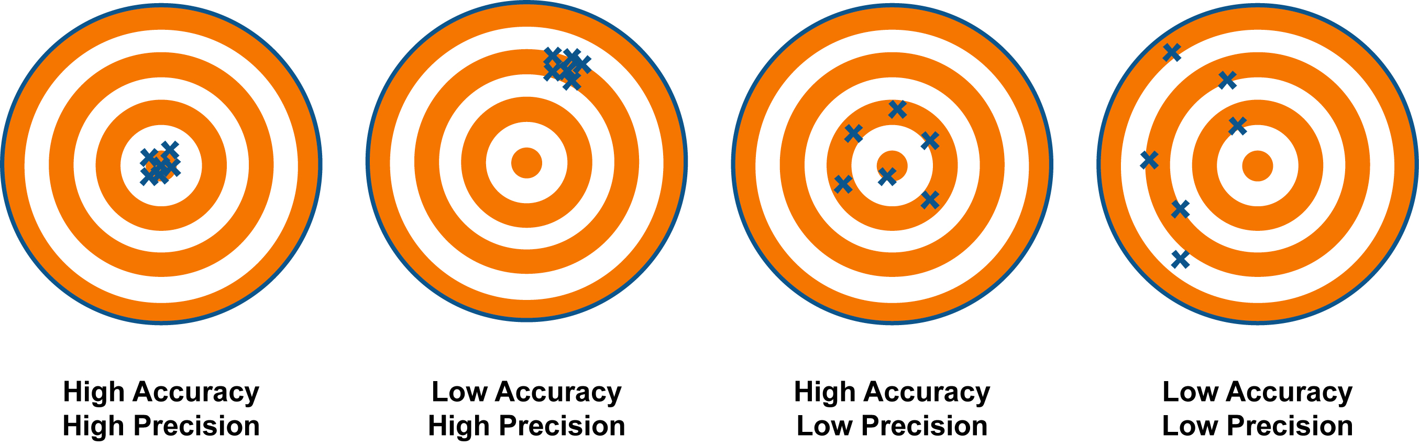
Talk about these images in terms of precision and accuracy.

Slide 9
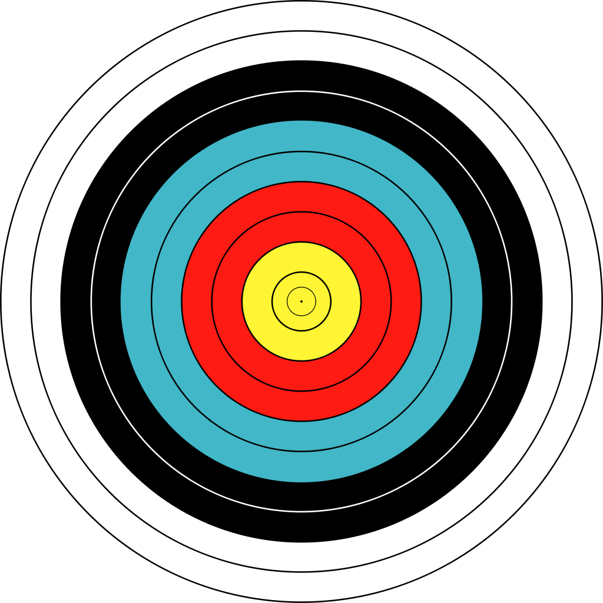
When collecting evidence or data…
Which is more important: accuracy or precision?
  Why??
Define both terms.
Sketch four archery targets and label:
  High precision, High accuracy
  High precision, Low accuracy
  Low precision, High accuracy
  Low precision, Low accuracy
Notes:
To illustrate the distinction between terms using a surveying example, imagine surveyors very carefully measuring the distance between two survey points about 30 meters (approximately 100 feet) apart 10 times with a measuring tape. All 10 of the results agree with each other to within two millimeters (less than one-tenth of an inch). These would be very precise measurements. However, suppose the tape they used was too long by 10 millimeters. Then the measurements, even though very precise, would not be accurate. Other factors that could affect the accuracy or precision of tape measurements include: incorrect spacing of the marks on the tape, use of the tape at a temperature different from the temperature at which it was calibrated, and use of the tape without the correct tension to control the amount of sag in the tape.

Slide 10
Notes:
HW: Writing Assignment → Why do scientists need to be both accurate and precise?
Reading Assignment → Read pink packet

Slide 11
Percent Error - Accuracy
The percent error is used when comparing the final measured value to a well-accepted or well-known value. The percent error is defined as:
Once the percent error or percent difference is known, the error analysis may proceed. Error analysis is the description of why two measured quantities differ. Usually, this discussion is about a final measured value and why it differs from a well-accepted or known value. Two main contributors factor into accounting for the discrepancy between the final measured value and the known value – these are accuracy and precision.

Slide 12
Standard Deviation - Precision
Used to tell how far on average any data point is from the mean.
The smaller the standard deviation, the closer the scores are on average to the mean.
When the standard deviation is large, the scores are more widely spread out on average from the mean.
When thinking about the dispersal of measurements, what term comes to mind?
Std Dev Link
Notes:
PRECISION!

Slide 13


The bell curve which represents a normal distribution of data shows what standard deviation represents.
One standard deviation away from the mean ( ) in either direction on the horizontal axis accounts for around 68 percent of the data. Two standard deviations away from the mean accounts for roughly 95 percent of the data with three standard deviations representing about 99 percent of the data.

Slide 14
Find Standard Deviation
Find the variance.
a) Find the mean of the data.
b) Subtract the mean from each value.
c) Square each deviation of the mean.
d) Find the sum of the squares.
e) Divide the total by the number of items.
Take the square root of the variance.

Slide 15
Recording the COMPLETE Measurement
Measurement
  Write what you know
  Include degree of freedom
Uncertainty (random error)
  Half of the smallest division on the scale
  Determined by the measuring device
Units
  Use metric unless otherwise instructed
  Common SI units: meters, liters, grams
Notes:
Pink Packet Day 2 Notes & Discussion

Slide 16
1. The Measurement
When you report a number as a measurement, the number of digits and the number of decimal places tell you how exact the measurement is.
What is the difference between 121 and 121.5?
The total number of digits and decimal places tell you how precise a tool was used to make the measurement.

Slide 17
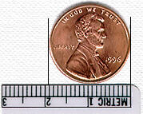
1. The Number: Degree of Freedom
Record what you know for sure
“Guess” or estimate your degree of freedom (your last digit)
Notes:
1.94 +/- .05 cm

Slide 18
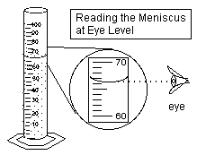
1. The Measurement: DOF cont.
Notes:
66.1 +/- .5 mL

Slide 19
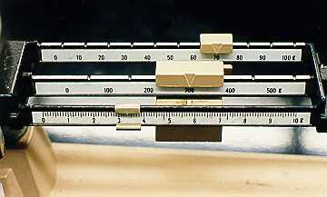
1. The Measurement: DOF cont.
Notes:
373.34 +/- .05 cm

Slide 20
2. The Uncertainty
No measure is ever exact due to errors in instrumentation and measuring skills. Therefore, all measurements have inherent uncertainty that must be recorded.
Two types of errors:
  Random errors: Precision (errors inherent in apparatus)
    Cannot be avoided
    Predictable and recorded as the uncertainty
    Half of the smallest division on a scale
  Systematic errors: Accuracy (errors due to “incorrect” use of equipment or poor experimental design)
    Personal errors – reduced by being prepared
    Instrumental errors – eliminated by calibration
    Method errors – reduced by controlling more variables

Slide 21
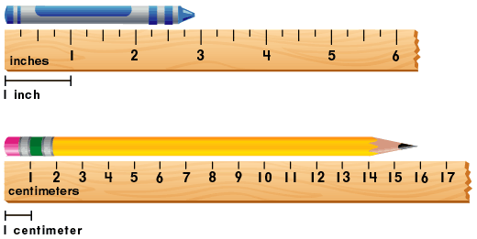
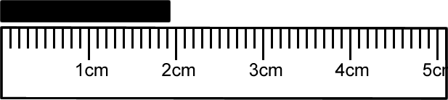
Precision vs. Accuracy
Precision → based on the measuring device
Accuracy → based on how well the device is calibrated and/or used

Slide 22
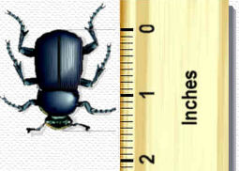
How big is the beetle?
Measure between the head and the tail!
Between 1.5 and 1.6 in
Measured length:
1.54 +/- .05 in
The 1 and 5 are known with certainty
The last digit (4) is estimated between the two nearest fine division marks.
Copyright © 1997-2005 by Fred Senese

Slide 23
How big is the penny?
Measure the diameter.
Between 1.9 and 2.0 cm
Estimate the last digit.
What diameter do you measure?
How does that compare to your classmates?
Is any measurement EXACT?
Copyright © 1997-2005 by Fred Senese

Slide 24
3. Units - Systems of Measurement
We collect data two ways: Quantitative and Qualitative
Why do we need a standardized system of measurement?
Video Link
  Scientific community is global.
  An international “language” of measurement allows scientists to share, interpret, and compare experimental findings with other scientists, regardless of nationality or language barriers.
Notes:
DAY 2 – overview of measurement…
Regular meter stick, shorter stick with the same 100 divisions….same precision, but different accuracy

Slide 25
3. Units - Metric System & SI
The first standardized system of measurement: the “Metric” system
  Developed in France in 1791
  Named based on French word for “measure”
  based on the decimal (powers of 10)
Systeme International d'Unites
(International System of Units)
  Modernized version of the Metric System
  Abbreviated by the letters SI.
  Established in 1960, at the 11th General Conference on Weights and Measures.
  Units, definitions, and symbols were revised and simplified.

Slide 26
3. SI Base Units
Physical Quantity | Unit Name | Symbol
length | meter | m
mass | kilogram | kg
time | second | s
volume | liters, meter cubed | L, m³
temperature | Kelvin | K

Slide 27
3. SI Prefixes
Prefix | Symbol | Numerical Multiplier | Exponential Multiplier
giga | G | 1,000,000,000 | 10⁹
mega | M | 1,000,000 | 10⁶
kilo | k | 1,000 | 10³
hecto | h | 100 | 10²
deka | dk | 10 | 10¹
no prefix means: |  | 1 | 10⁰
deci | d | 0.1 | 10¯¹
centi | c | 0.01 | 10¯²
milli | m | 0.001 | 10¯³
micro | μ | 0.000001 | 10¯⁶
nano | n | 0.000000001 | 10¯⁹
Notes:
We will revisit this when we do dimensional analysis…

Slide 28
Significant Figures
Indicate precision of a measured value
  1100 vs. 1100.0
  Which is more precise? How can you tell?
  How precise is each number?
  Determining significant figures can be tricky.
  There are some very basic rules you need to know. Most importantly, you need to practice!
Notes:
DAY 3…

Slide 29
Counting Significant Figures
The Digits | Digits That Count | Example | # of Sig Figs
Non-zero digits | ALL | 4.337 | 4
Leading zeros (zeros at the BEGINNING) | NONE | 0.00065 | 2
Captive zeros (zeros BETWEEN non-zero digits) | ALL | 1.000023 | 7
Trailing zeros (zeros at the END) | ONLY IF they follow a significant figure AND there is a decimal point in the number | 89.00 but 8900 | 4 2
Leading, Captive AND Trailing Zeros | Combine the rules above | 0.003020 but 3020 | 4 3
Scientific Notation | ALL | 7.78 x 10³ | 3

Slide 30
Calculating With Sig Figs
Type of Problem | Example
MULTIPLICATION OR DIVISION: Find the number that has the fewest sig figs. That's how many sig figs should be in your answer. | 3.35 x 4.669 mL = 15.571115 mL rounded to 15.6 mL 3.35 has only 3 significant figures, so that's how many should be in the answer. Round it off to 15.6 mL
ADDITION OR SUBTRACTION: Find the number that has the fewest digits to the right of the decimal point. The answer must contain no more digits to the RIGHT of the decimal point than the number in the problem. | 64.25 cm + 5.333 cm = 69.583 cm rounded to 69.58 cm 64.25 has only two digits to the right of the decimal, so that's how many should be to the right of the decimal in the answer. Drop the last digit so the answer is 69.58 cm.

Slide 31
Dimensional Analysis
My friend from Europe invited me to stay with her for a week. I asked her how far the airport was from her home. She replied, “40 kilometers.” I had no idea how far that was, so I was forced to convert it into miles! : )
This same friend came down with the stomach flu and was explaining to me how sick she was. “I’m down almost 3 kg in two weeks!” Again, I wasn’t sure whether to send her a card or hop on a plane to see her until I converted the units.
Usain Bolt ran the 100. meter dash in 9.58 seconds. If he was racing a car that was driving 25 miles per hour, who would win?
Notes:
A foreign exchange student from Norway is playing volleyball for LL this year. We asked her how tall she was for the roster, and she said 171. We laughed and then she said 67 inches….we laughed again!

Slide 32
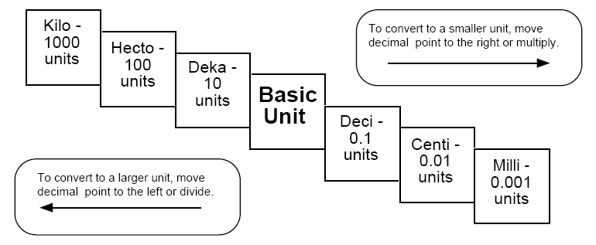
“Staircase” Method
Draw and label this staircase every time you need to use this method, or until you can do the conversions from memory

Slide 33
“Staircase” Method: Example
Problem: convert 6.5 kilometers to meters
  Start out on the “kilo” step.
  To get to the meter (basic unit) step, we need to move three steps to the right.
  Move the decimal in 6.5 three steps to the right
  Answer: 6500 m

Slide 34
“Staircase” Method: Example
Problem: convert 114.55 cm to km
  Start out on the “centi” step
  To get to the “kilo” step, move five steps to the left
  Move the decimal in 114.55 five steps the left
  Answer: 0.0011455 km

Slide 35
Big Fat Fractions
Conversion Factor: a fraction that relates the original unit and the desired unit.
  Conversion factor is always equal to 1.
  Numerator and denominator should be equivalent measurements.
When measurement is multiplied by conversion factor, original units should cancel

Slide 36
5 Steps to BFF
Look at what you’re starting with.
Identify the desired units.
Find the conversion.
Decide which conversion factor will allow you to cancel the appropriate units.
Multiply and divide as needed and check sig figs.

Slide 37
BFF: Example
Convert 6.5 km to m
First, we need to find a conversion factor that relates km and m.
  We should know that 1 km and 1000 m are equivalent (there are 1000 m in 1 km)
  We start with km, so km needs to cancel when we multiply. So, km needs to be in the denominator

Slide 38
BFF: Example
Multiply original measurement by conversion factor and cancel units.

Slide 39
BFF: Example
Convert 3.5 hours to seconds
If we don’t know how many seconds are in an hour, we’ll need more than one conversion factor in this problem

Slide 40
Purpose of Evidence
Evidence is used to develop theories, generalize data to form laws, and propose hypotheses.
Theory –well-tested explanation of things or events based on knowledge gained from many observations and investigations
  Can theories change? What about if you get the same results over and over?
Law – a statement about what happens in nature and that seems to be true all the time
  Tell you what will happen, but don’t always explain why or how something happens
Hypothesis – explanatory statement that could be true or false, and suggests a relationship between two factors.
Notes:
Theory of Plate Tectonics, Big Bang Theory, Theory of General Relativity
Newton’s Laws of Motion, Universal Law of Gravitation, Law of Conservation of (energy, mass, momentum, etc.), Hubble’s Law, Kepler’s Law of planetary motion (3 laws), Law of Thermodynamics (energy in a system)

Slide 41
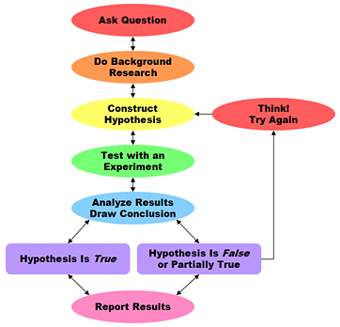
Ch 1.2: Using a Scientific Approach, pg 7-11
(Objectives 4&5)
Set of investigation procedures
General pattern
May add new steps, repeat steps, or skip steps

Slide 42
Bubble Gum Example
Problem/Question: How does bubble gum chewing time affect the bubble size?
Gather background info…
Hypothesis: The longer I chew the larger the bubble.
Experiment…
  Independent variable – chew time
  Dependent variable – bubble size
  Controlled variables – type of gum, person chewing, person measuring, etc.
Analyze data – 1 minute → 3 cm bubble, 3 minutes → 7 cm bubble…30 minutes → 5 cm…
Conclusion – there is an optimum length of chewing gum that yields the largest bubble
What next? Now try testing…
Notes:
How does the pull back distance of a rubber band affect the distance a paper wad travels?
What do you know about them? What could our question be? Hypothesis?
Materials/Procedure?
Data table?
Graph?

Slide 43
Group Discussion Questions
1&6 – What is the scientific method and its goal?
2&7 – What is a hypothesis and how is it formed?
3&8 – What are the types of variables in a controlled experiment and how are they different?
4&9 – What is the difference between scientific theory and scientific law?
5&10 – What is a scientific model and how are they useful?

Slide 45
1: Recording raw data
Raw data – actual data measured
Includes quantitative and qualitative data
Uncertainties are identified
Data is collected into tables with:
  Variables and trials identified
  Cells contain only one value
  Values are aligned by decimal point
  Clear headings and titles
  All measurements contain units and uncertainties with appropriate and consistent significant digits

Slide 46
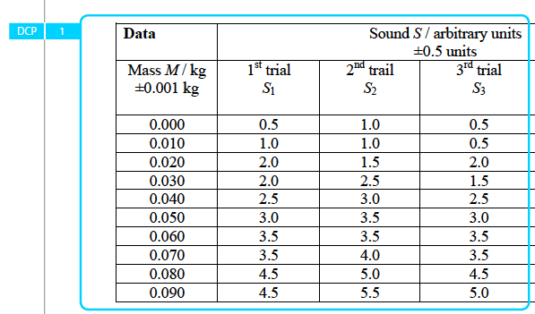
Parts of a Data Table

Slide 47
2: Processing Raw Data
All raw data has been completely processed
  Adding, subtracting, squaring, dividing, etc.
Sample calculations are present & clearly explained
Calculations show propagation of uncertainty
Involves taking the average of several measurements and transforming data into a form suitable for graphical representation

Slide 48
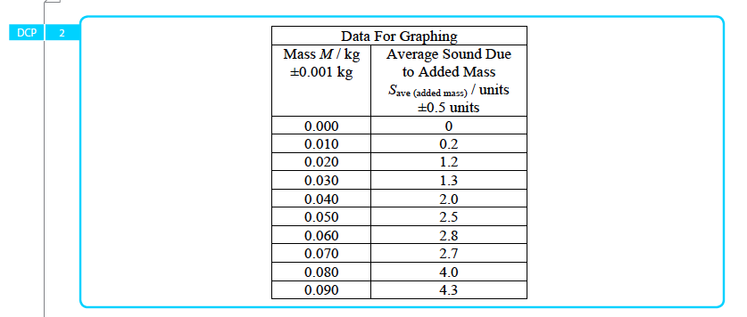
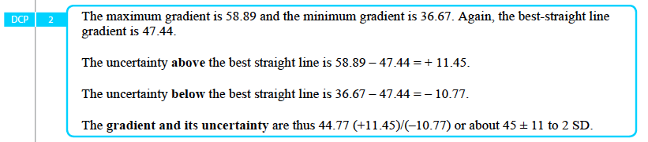
Data Table: Processed Data

Slide 49
Chapter 1.4: Presenting Scientific Data, pg 22-25 (Objective 5)
Graph – visual display of information or data
Scientists graph the results of their experiment to detect patterns easier than in a data table.
Line graphs – show how a relationship between variables change over time
  Ex: how stocks perform over time
Bar graphs – comparing information collected by counting
  Ex: Graduation rate by school
Circle graph (pie chart) – how a fixed quantity is broken down into parts
  Ex: Where were you born?

Slide 50
Parts of a Graph
Title: Dependent Variable Name vs. Independent Variable Name
X and Y Axes
  X-axis: Independent Variable
  Y-axis: Dependent Variable
  Include label and units
  Appropriate data range and scale.
Data pairs (x, y): plot data, do NOT connect points.
Best Fit Line to see general trend of data.
Graphs/tables have annotations describing graphical relationships
Notes:
To get into club XY, you gotta bring your ID : )

Slide 51
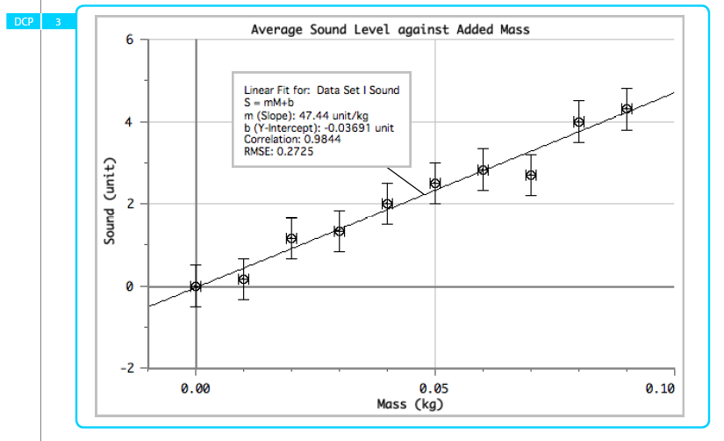
Parts of a Graph

Slide 52
Mark Schemes (Objectives 4&5)
Rubric used to assess IB labs
9th graders will only focus on 2 parts of the rubric: Exploration and Analysis

Slide 53
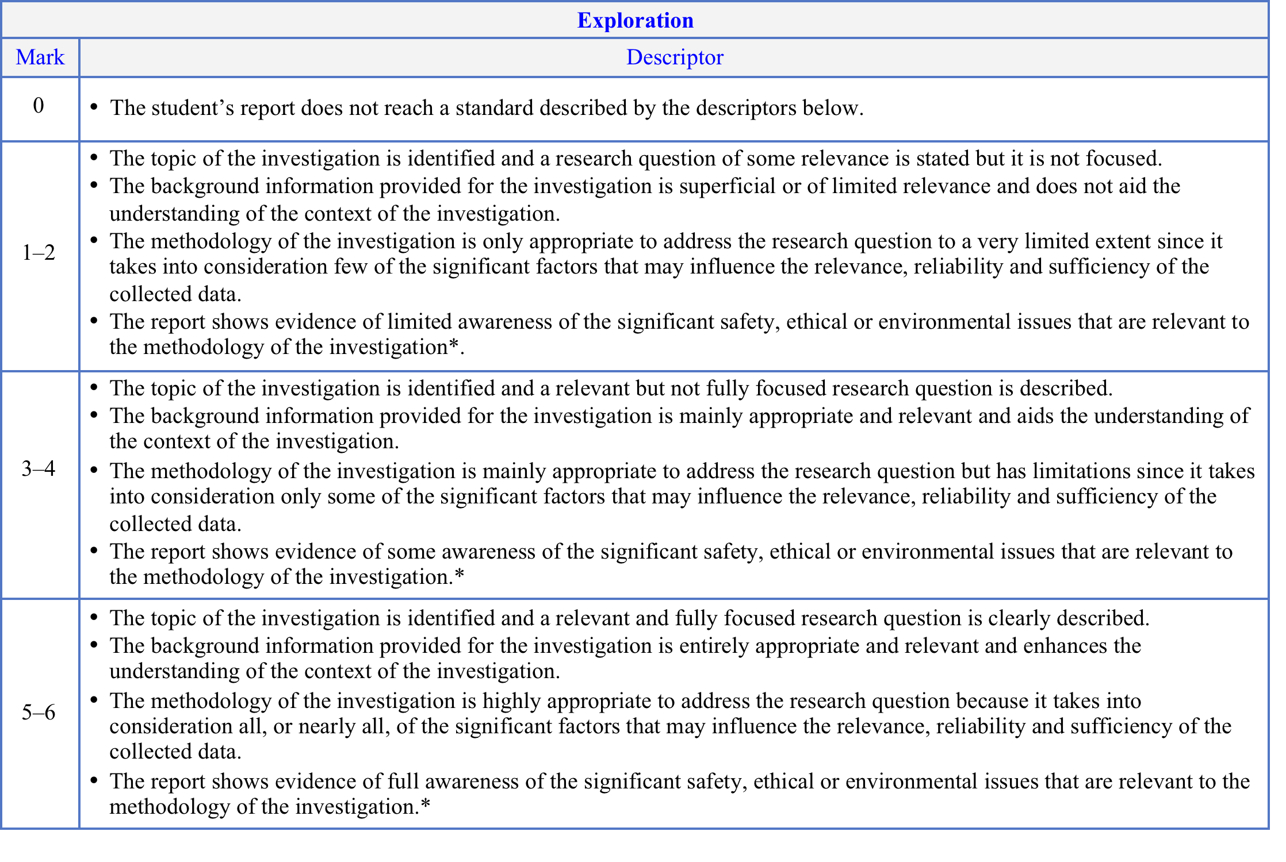
Exploration

Slide 54
Exploration Checklist
____ Focused research question or problem-- may include a clear hypothesis
____ Introduction describes current knowledge on topic and provides clear overview of this
investigation
____ Independent variable (I.V.) & Dependent variable is (D.V.) are identified and quantitative
____ Controlled variable(s) is/are identified and justified
____ Materials list is provided
____ Safety, ethical or environmental considerations are described
____ Method describes how the I.V. will be manipulated—should include description of
sample sizes, trials & replicates
____ Method describes how controlled variables are held constant—needs to be clear and
concise
____ Describe apparatus & setup and/or provides a diagram/picture with annotations—
including materials specific to the
investigation
____ If applicable, cite reference for standard collection procedure—use CBE/CSE, MLA or
APA
____ Methods are not written in person-point-of-view
____ Method describes how the D.V. will be measured
____ Method describes how data will be collected/measured
____ Method provides for collection of sufficient data points (5 recommended)
____ Method provides for replication of data points (3-5 replicates per data point / consistent
results are met)

Slide 55
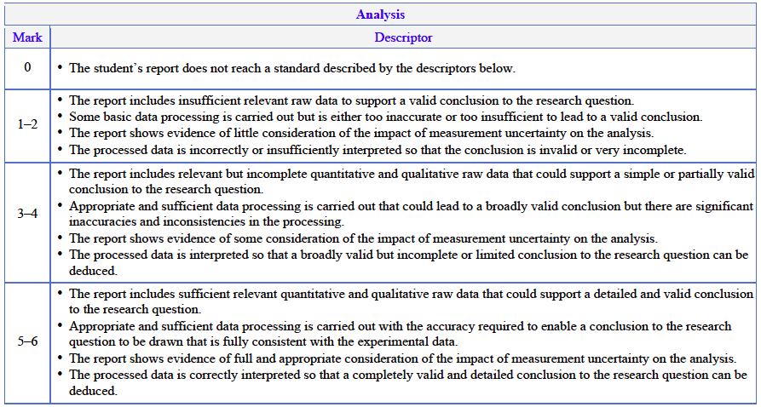
Analysis

Slide 56
Analysis Checklist
____ all relevant raw data has been included—both quantitative & qualitative
____ uncertainties of measures are identified
____ data is collected into tables with:
  I.V. values and trials/replicates are identified
  Cells contain only one value
  Values are aligned (by decimal point)
____ data tables contain headings—both table title and columns/rows
____ all measurements contain units and uncertainties (written in the column heading)-
____ measures and uncertainties have the same significance (same place)-
____ all raw data has been completely processed (e.g. calculations, graphed and statistical analyses
performed)
____ sample calculations are present & clearly explained-
  standard calculations need not be shown but referenced (e.g. sum, mean, & standard deviation)
____ calculations show propagation of uncertainty (addition/subtraction vs. multiplication/division)-
____ a suitable format (graphs/tables) shows the relationship between I.V. & D.V.
____ graphs/tables have proper titles—identifying the variables included in the table
____ graphs have appropriate scales, labeled axes with units & uncertainties and accurately plotted data
  A suitable best fit line/curve with appropriate equation is present
____ tables/graphs have annotations describing graphical relationships
____ statistical analyses of error is incorporated when prompted (e.g. standard deviation, error bars, max./min. slopes)

Slide 57
Homework
Outline the design of a lab relating two variables…
  Correlation – statistical link or association between two variables
    EX: families that eat dinner together have a decreased risk of drug addiction,
  Causation – one factor causing another
    EX: smoking causes lung cancer
  Be sure your variables are measurable and have some sort of causal relationship. Include a title, question, hypothesis, materials, and procedure
Read Pink Packet…
Notes:
END DAY 1 (sci meth focus)

