Slide 1
Unit 9: Astronomy
HPS 2018

Slide 2
Objective 1: history of astronomy
WHY STUDY ASTRONOMY?
People have been studying the night sky for thousands of years…
Gave us our first calendar: days, months, years
ORDER! So they are able to anticipate events.
Told people when to plant, when to harvest
Influence architecture (perhaps pyramids)
Pertain to religions (soul of Pharaoh launched to Cyrus for eternal life)
Helps navigation

Slide 3
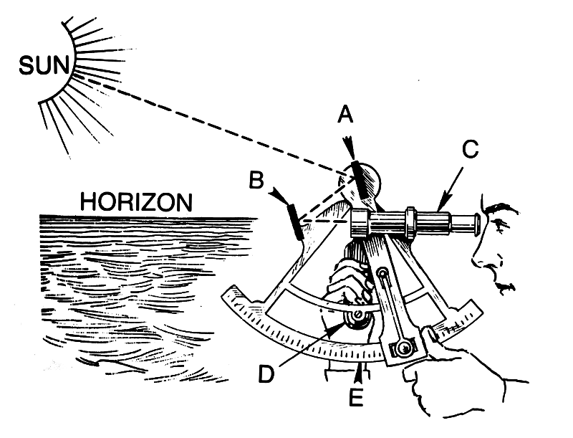
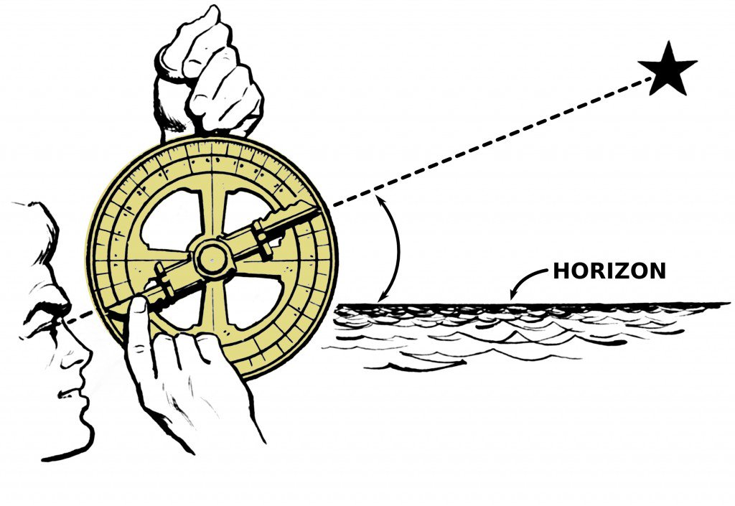
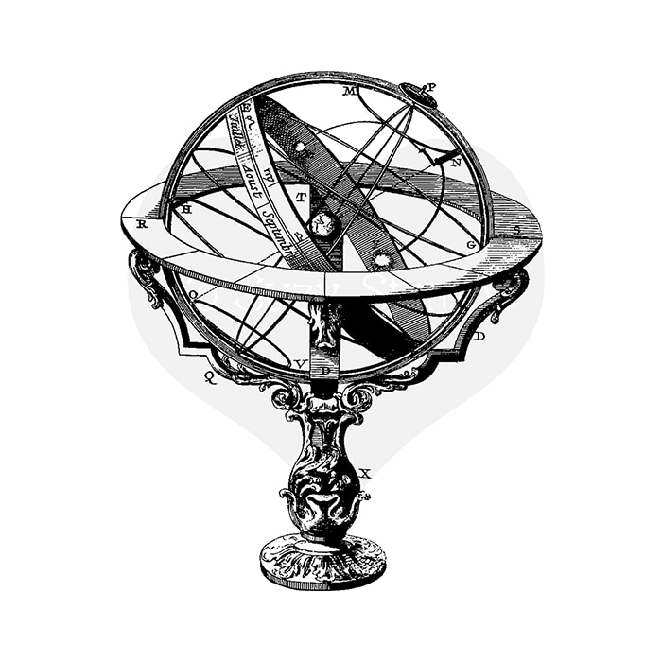
How? Naked eye Tools of early astronomers
Astrolabe
Sextant
Armillary sphere
Notes:
Astrolabe – simple tool, 1 dimensional
Armillary sphere – 3D tool, specialized astrolabe
Sextant – part of armillary sphere

Slide 4
Hipparchus and ptolemy
DATE | LOCATION | EVENT (NAKED EYE ASTRONOMY)
~130 B.C. | GREECE | Hipparchus develops the first accurate star map and star catalogue with over 850 of the brightest stars.
140 B.C. | GREECE | Ptolemy "perfects" geocentric model of solar system. Ptolemy's universe showed the Earth at the center, with the moon, Mercury, Venus, the Sun, Mars, Jupiter, and Saturn, in succeeding celestial spheres. Ptolemy (like Aristotle) believed that the heavenly bodies moved in perfect circles; unlike earthly bodies which were flawed and moved in straight lines. Ptolemy also compiled a catalog of stellar brightnesses based partly on the earlier catalog of Hipparchus.

Slide 5
copernicus
DATE | LOCATION | EVENT (NAKED EYE ASTRONOMY)
1543 A.D. | POLAND | Video Link Copernicus publishes "De Revolutionibus". De Revolutionibus, Copernicus's heliocentric system placed the Sun immobile at the center of the other planets in the correct order: Mercury, Venus, Earth, Mars, Jupiter, Saturn. He, like Ptolemy, thought the planets moved in circles. The writing was published two months before his death. **Retrograde motion** He was a mathematician, astronomer, religious figure, scientist, scholar…and a monk. Ptolemy’s ideas of an earth-based solar system were far more accepted by the influential Roman Catholic Church. In fact, when Copernicus’s De Revolutionibus was published in 1543, religious leader Martin Luther voiced his opposition to the heliocentric solar system model, and the Roman Catholic Church viewed Copernicus’ theories as heretical. Copernicus dedicated his publication to Pope Paul III, but the Catholic Church ultimately banned the publication in 1616.
Notes:
Retrograde motion: As Earth passes the slower-moving outer planets, they seem to be moving backward. When we pass Jupiter or Mars or Saturn, for example, these more outward planets in orbit – which move more slowly than Earth in orbit – appear to reverse course in our sky for a couple of months.

Slide 6
Brahe and kepler
DATE | LOCATION | EVENT (NAKED EYE ASTRONOMY)
1572 A.D. | DENMARK | Video Link and Tools Link Tycho Brahe carries out best pre-telescopic observations ever. Tycho's observations, made using specially built instruments, were the most accurate ever made with the naked eye. Tycho also invented his own geocentric model of the solar system, a combination of Ptolemaic and Copernican systems, suggesting the Sun and moon revolve around Earth, while the other planets revolved around the Sun.
1609 A.D. – Laws 1 & 2 1619 A.D. - Law 3 | GERMANY | Kepler’s worked for Brahe until Brahe’s death. Then he used Brahe’s data to make his own model with elliptical orbits instead of round orbits. He developed Laws of Planetary Motion: 1. Planets move in ellipses around the sun, 2. Planets move proportionally faster in their orbit nearer the Sun, 3. More distant planets take proportionally longer to orbit the Sun. Was one of a few vocal supporters of Galileo’s discoveries and of the Copernican system.

Slide 7
galileo
DATE | LOCATION | EVENT (AIDED EYE ASTRONOMY)
1609 A.D. 1632 A.D. | ITALY | Galileo uses refracting telescope for astronomical observations. Galileo didn't invent the telescope but he was among the first to use a telescope for astronomical purposes. He supported the Copernican, heliocentric solar system and carried out important observations of the Sun, Moon, Planets, and Stars. His research validates Kepler’s model. Video Link The Copernican theory was pronounced heretical by the church. In 1616, Galileo was ordered not to “hold, teach, or defend in any manner” the Copernican theory. He obeyed for 7 years because he was a devoted Catholic. Galileo’s friend was elected as Pope Urban VII and encouraged him to pursue his work on astronomy as long as it did not advocate the Copernican theory. But he did. He was summoned to Rome where he was questioned for almost a year. He finally admitted he had supported Copernican theory. He was convicted of heresy and spent his remaining years under house arrest. *In 1758 the ban was lifted, and in 1992 Pope John Paul II expressed regret about how the Galileo affair was handled.
Notes:
In 1613, Galileo wrote a letter to a student to explain how Copernican theory did not contradict Biblical passages, stating that scripture was written from an earthly perspective and implied that science provided a different, more accurate perspective. The letter was made public and Church Inquisition consultants pronounced Copernican theory heretical. In 1616, Galileo was ordered not to “hold, teach, or defend in any manner” the Copernican theory. Galileo obeyed the order for seven years, partly to make life easier and partly because he was a devoted Catholic.
In 1623, a friend of Galileo, Cardinal Maffeo Barberini, was elected as Pope Urban VIII. He allowed Galileo to pursue his work on astronomy and even encouraged him to publish it, on condition it be objective and not advocate Copernican theory. This led Galileo to publish Dialogue Concerning the Two Chief World Systems in 1632, which advocated the theory.
Church reaction was swift, and Galileo was summoned to Rome. Galileo’s Inquisition proceedings lasted from September 1632 to July 1633. During most of this time, Galileo was treated with respect and never imprisoned. However, in a final attempt to break him, Galileo was threatened with torture, and he finally admitted he had supported Copernican theory, but privately held that his statements were correct. He was convicted of heresy and spent his remaining years under house arrest.
Though ordered not to have any visitors nor have any of his works printed outside of Italy, he ignored both. In 1634, a French translation of his study of forces and their effects on matter was published, and a year later, copies of the Dialogue were published in Holland. While under house arrest, Galileo wrote Two New Sciences, published in Holland in 1638. By this time, Galileo had become blind and in ill health.
In time, however, the Church couldn’t deny the truth in science. In 1758, it lifted the ban on most works supporting Copernican theory. By 1835, it dropped its opposition to heliocentrism altogether. In the 20th century, several popes acknowledged the great work of Galileo, and in 1992, Pope John Paul II expressed regret about how the Galileo affair was handled.

Slide 8
newton
DATE | LOCATION | EVENT
1668 A.D. | ENGLAND | Newton’s first major public scientific achievement was designing and constructing a reflecting telescope.
1687 A.D. | ENGLAND | Newton’s three basic laws of motion helped him arrive at his theory of gravity, which he published in 1687. Gravity was the force that kept planets in their orbits (holds the moon around the Earth, Earth around the Sun, etc.)

Slide 9
Hubble
DATE | LOCATION | EVENT
1929 A.D. | USA | Hubble discovers universe is expanding. Hubble found that the speed of recession of galaxies increases with distance. He explained that this is due to the expansion of the universe. Video Link Recessional Velocity = Hubble's constant times distance V = H_{o} D where V is the observed velocity of the galaxy away from us, usually in km/sec H is Hubble's "constant", in km/sec/Mpc D is the distance to the galaxy in Mpc Today the value is still rather uncertain, but is generally believed to be in the range of 45-90 km/sec/Mpc. In general, galaxies follow the smooth expansion where the more distant ones move faster away from us.

Slide 10
Penzias and wilson
DATE | LOCATION | EVENT
1964 A.D. | USA | Two young radioastronomers, Arno Penzias and Robert Wilson, accidentally discovered the CMB using a well-calibrated horn antenna. They were trying to determine what was causing static in telephone lines. They worked for Bell Telephone company. Cosmic Microwave Background radiation (CMB’s) : the existence of radiation that permeates the entirety of the Universe and is believed to be leftover radiation from the Big Bang. CMB PBS Video Clip (5 min)

