Slide 1
Waves
Unit 6

Slide 2
The Nature of Waves
What’s in a Wave?
A wave is a repeating disturbance or movement that transfers energy through matter or space
Waves and Energy
The molecules of the substance transfer some of the energy to neighboring molecules causing them to move (think Dominoes)
Waves only carry energy, they do not transport matter (PICTURE)
All waves are produced by a disturbance or vibrations (NEXT)

Slide 3
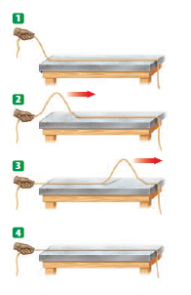
Waves Only Carry Energy
BACK

Slide 4
The Nature of Waves, continued
Two Types of Waves:
Mechanical Waves
Require a medium
- A medium is the matter through which waves travel
- May be solid, liquid or gas
Ex: Water waves, sound waves
Electromagnetic Waves
Do not require a medium
Ex: Light waves

Slide 5
The Nature of Waves, continued
Mechanical Waves
There are two types of mechanical waves:
Transverse waves
Matter moves back and forth at right angles (perpendicular) to the direction of the wave (PICTURE)
Example: water waves
Compressional waves
Matter moves in the same direction (parallel) as the direction of the wave (PICTURE)
Example: sound waves
Some waves are a combination of transverse and compressional (PICTURE)
Example: ocean waves and seismic waves

Slide 6
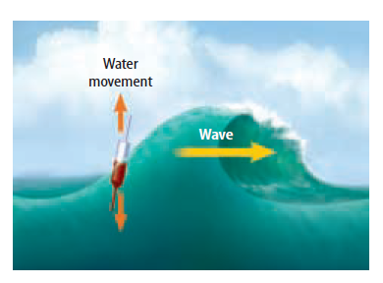
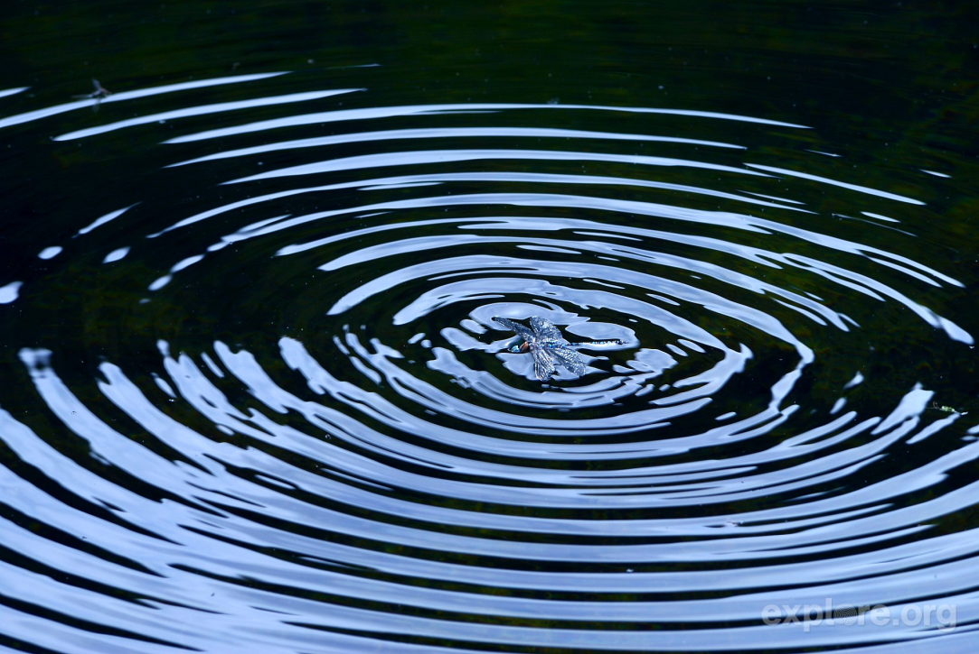
Transverse Wave
BACK

Slide 7
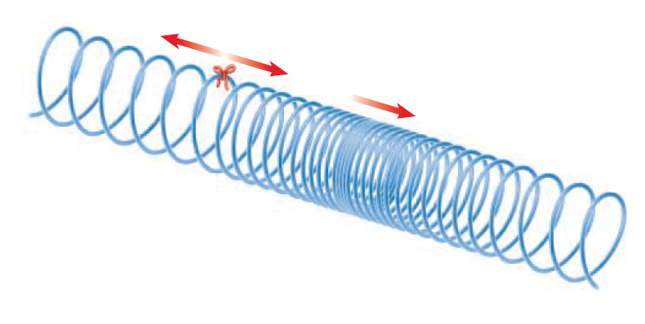
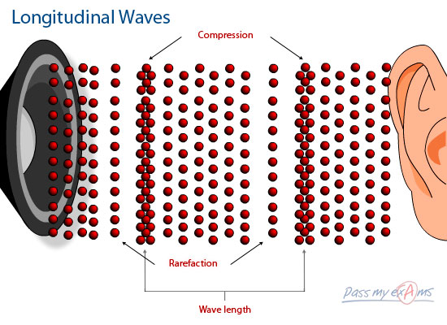
Compressional Wave
BACK

Slide 8
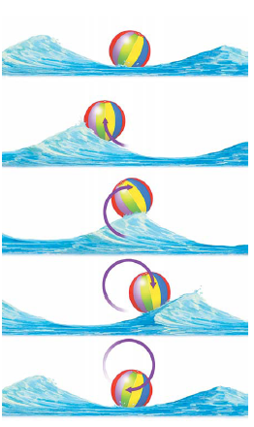
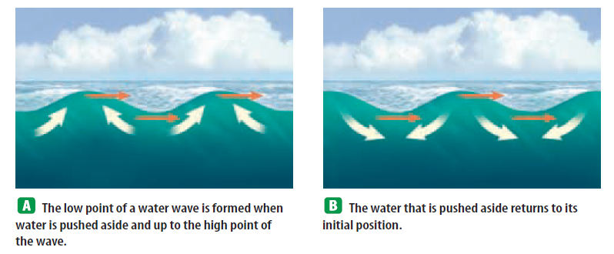
Combination (Surface) Waves
BACK

Slide 9
Warm-up
Waves carry __________ through matter or space.
True or False: Waves are caused by a disturbance.
A wave that requires a medium is called a ________ wave.
The only type of wave that does not require a medium is a ____________ wave.
Light is an example of a (transverse /compressional) wave.
Sound is an example of a (transverse /compressional) wave.

Slide 10
Wave Properties
The Parts of a Wave
Waves differ in the following ways:
How much energy they carry
How fast they travel
How they look
Transverse waves have high points and low points
Highest point = crest
Lowest point = trough
Compressional waves have regions of high and low density
High density (squished) regions = compressions
Low density (stretched) regions = rarefactions (PICTURE) (NEXT)

Slide 11
Different Looks
BACK

Slide 12
Wave Properties, continued
Wavelength
The wavelength is the distance from one point on a wave and the nearest point just like it

Slide 13
Wave Properties, continued
Frequency
The number of wavelengths that pass a fixed point each second
Measures in hertz (Hz or 1/s)
As the frequency increases, wavelength decreases (PICTURE)
Frequency is always equal to the rate of vibrations of the sources that creates it
If you move a rope up-and-down once, the frequency is 1 Hz
If you move a rope up-and-down fives times, the frequency is 5 Hz
The opposite of frequency is period
The time that it takes a complete cycle or wave oscillation to occur (NEXT)
T = 1/f

Slide 14
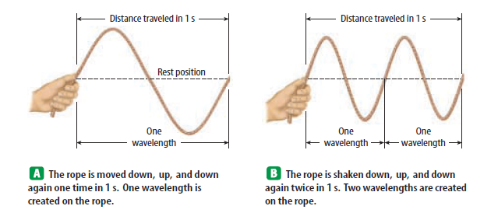
Wavelength and Frequency Relationship
BACK

Slide 15
Wave Properties, continued
Amplitude
A measure of the energy in a wave
The greater the energy the wave carries, the greater its amplitude
The amplitude of compressional waves is related to how tightly the medium is pushed together
The denser the compressions, the larger the amplitude (and energy)
The less dense the rarefactions, the larger the amplitude (and energy) (PICTURE)
The amplitude of transverse waves is the distance from the crest or trough to the normal position of the medium (PICTURE)
Examples: how high an ocean wave appears above the water level (NEXT)

Slide 16
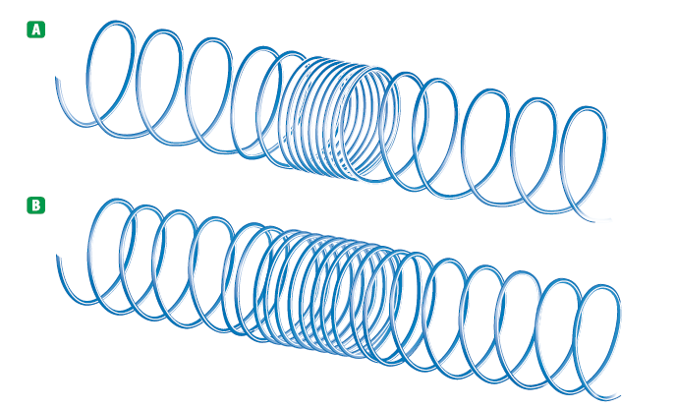
Amplitude of Compressional Waves
BACK

Slide 17
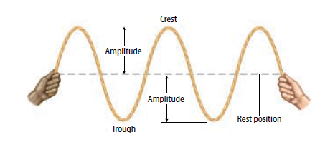
Amplitude of Transverse Waves
BACK

Slide 18
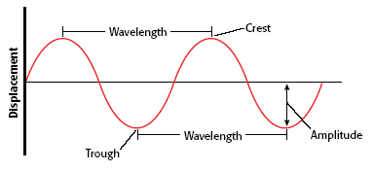
Typical Wave
How many wavelengths are there?
What is the frequency of this wave?
What is the period of this wave?
1 second

Slide 19
Warm-Up
Time required for one wave-length to pass a given point
Greatest distance particles are displaced from resting position
Highest point of a transverse wave
Distance from one crest to the next or one compression to the next
Relationship between period and frequency
Wavelength
f = 1/T
Crest
Amplitude
Period

Slide 20
Wave Properties, continued
Wave Speed
Wave speed equals frequency times wavelength
Light waves travel faster than sound waves
Sound waves travel faster in liquids and solids than in gases
Light travels faster in gases and empty space than in liquids and solids
(FURTHER EXPLANATION) or (EXAMPLE PROBLEMS)

Slide 21
Wave Properties, continued
EXTRA INFORMATION!
Use only if further explanation needed
Wave Speed
The speed of a wave depends on the medium.
The arrangement of particles (kinetic theory) in a medium determines how well waves travel through it
In gases, the molecules are far apart and move around randomly (PICTURE)
Thus, waves don’t travel as fast in gases
In liquids, such as water, the molecules are much closer together (PICTURE)
But they are also free to slide past one another
In a solid, molecules are not only closer together but also tightly bound to each other (PICTURE)
Waves travel very quickly through most solids
Notes:
Use this slide for extra information if students are confused about why different waves travel through different materials at different speeds

Slide 22
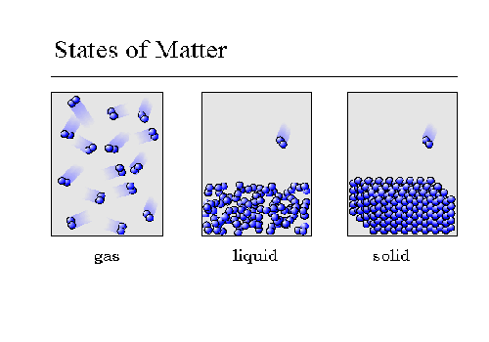
Kinetic Theory - Gases
EXTRA INFORMATION!
Use only if further explanation needed
BACK
Notes:
Use this slide for extra information if students are confused about why different waves travel through different materials at different speeds

Slide 23
Kinetic Theory - Liquids
EXTRA INFORMATION!
Use only if further explanation needed
BACK
Notes:
Use this slide for extra information if students are confused about why different waves travel through different materials at different speeds

Slide 24
Kinetic Theory - Solids
EXTRA INFORMATION!
Use only if further explanation needed
BACK
Notes:
Use this slide for extra information if students are confused about why different waves travel through different materials at different speeds

Slide 25
Kinetic Theory
EXTRA INFORMATION!
Use only if further explanation needed
Notes:
Use this slide for extra information if students are confused about why different waves travel through different materials at different speeds

Slide 26
Wave Equation Examples
An FM radio station broadcasts electromagnetic waves at a frequency of 945,000,000 Hz. These radio waves have a wavelength of 3.17 m. What is the speed of the waves?
Green light has a wavelength of 0.00000052 m. The speed of light is 300,000,000 m/s. Calculate the frequency of green light.
The speed of sound in air is about 340 m/s. What is a wavelength of sound wave with a frequency of 220 Hz?

Slide 27
Magnetic Field Brief Notes:
What is a magnetic force?
Magnetic field?
Magnetic fields look like?
Movement of magnets produces what?

Slide 28
Magnet Vocabulary
Magnetic force - The force a magnet exerts on:
1. Another magnet
2. Iron or a similar metal
3. A moving charges
Magnetic poles – regions where the magnet’s force is strongest
North pole and south pole
Opposites attract, likes repel
As distance increases, force decreases (vice versa)
A magnet is surrounded by a magnetic field
All magnets have a magnetic field!!!

Slide 29
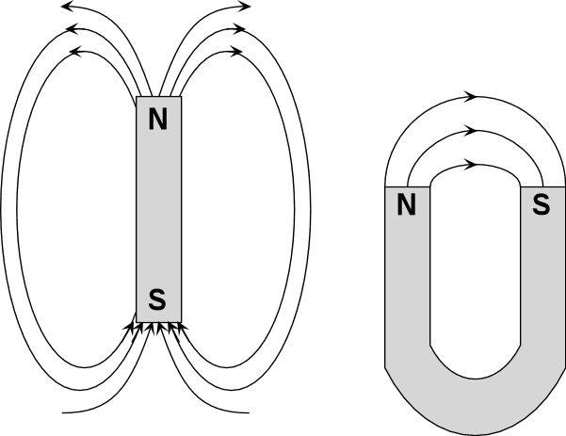
Magnetic Field
Definition- area around a magnet that exerts the magnetic force
Magnets have a North & South pole (which attract with each other)

Slide 30
Magnetic Materials
Electrons act like tiny magnets.
Certain materials like iron, nickel, and cobalt make a strong magnetic field.
These fields combine to form magnetic domains.
Magnetic domain is a region that has a very large number of atoms with aligned magnetic fields.
When a material is magnetized, most of its magnetic domains are aligned.

Slide 31
What are Electromagnetic Waves?
Electromagnetic waves do not require matter to transfer energy
They can travel through empty space
Electromagnetic waves are made by vibrating electric charges
Any object that carries charge and moves with a nonzero acceleration radiates EM waves. (Steadily moving objects do not radiate.)
Everything in the Universe emits EM radiation over a continuum of wavelengths. (above absolute zero)

Slide 32
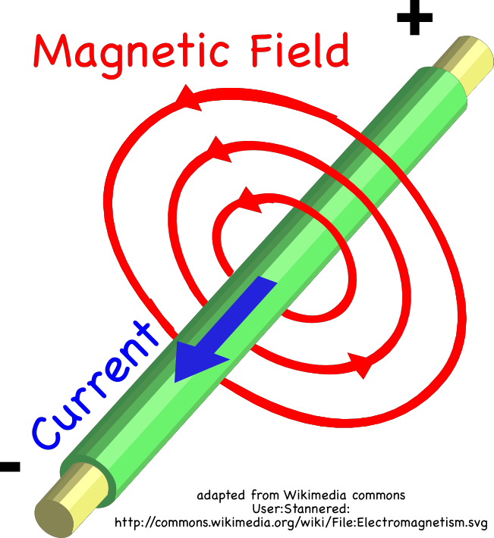

Slide 33
How are EM Waves produced?
Making Electromagnetic Waves
When an electric charge vibrates, the electric field around it vibrates
This creates a magnetic field
The magnetic field changes as the charge moves back and forth
This causes changes in the electric field
This process continues over and over
The electric and magnetic fields are perpendicular to each other and travel outward from the moving charge (PICTURE)

Slide 34
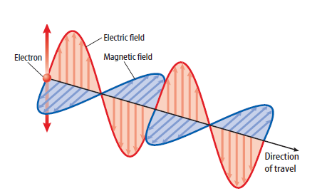
Electromagnetic Wave

Slide 35
The Electromagnetic Spectrum
A Range of Frequencies
Light comes in a wide range of frequencies, and thus wavelengths
As a result, the have different names

Slide 36
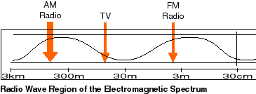
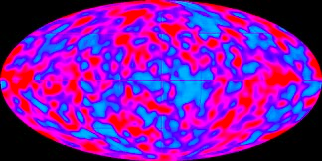
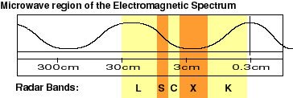
The Electromagnetic Spectrum, continued
Radio Waves
Radio waves are low-frequency electromagnetic waves with large wavelengths
RADAR and MRIs
Microwaves
Low frequency with wavelengths less than 1 m
Wavelengths of 1 cm to 10 cm are used for cell phones and satellite signals
Cosmic Background Radiation, Doppler RADAR, Pics from satellites

Slide 37
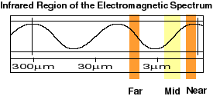
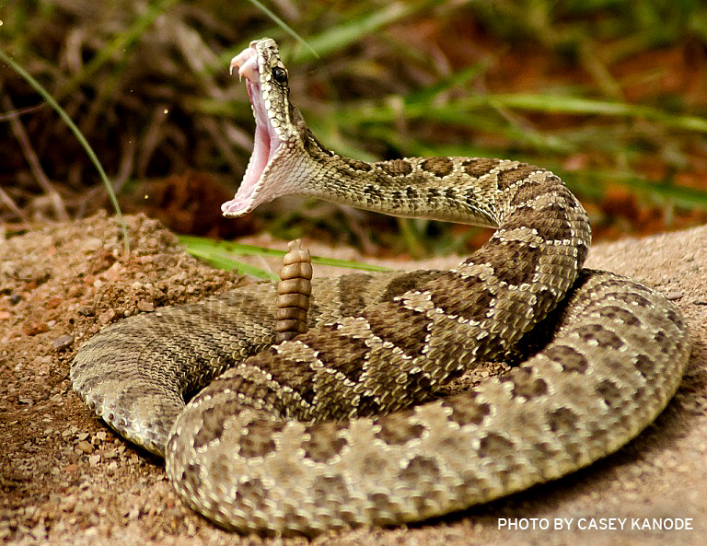
The Electromagnetic Spectrum, continued
Infrared Waves
Wavelengths range from about 1 mm to 750 billionths of a meter (750/1,000,000,000)
Far – Size of pin head - Warmth/heat you feel is thermal energy emitted through infrared waves
Near – Size of cells – Shorter wavelengths used by TV’s remote
We emit and snakes in the pit viper family can image

Slide 38
The Electromagnetic Spectrum, continued
Visible Light
Our eyes can detect light with wavelengths ranging from about 400 billionths ($\frac{400}{1,000,000,000})$to 750 billionths of a meter ($\frac{750}{1,000,000,000}$)
this range is called visible light

Slide 39
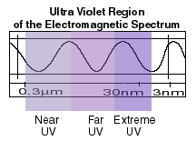
The Electromagnetic Spectrum, continued
Ultraviolet Waves
Electromagnetic waves with wavelengths from 400 billionths ($\frac{400}{1,000,000,000}$) of a matter to 10 billions of a meter ($\frac{10}{1,000,000,000}$)
Some UV radiation is good for us – it allows our bodies to make vitamin D needed for healthy bones and teeth
Overexposure to UV radiation can cause skin damage and cancer
Some blocked by ozone
Bees and some other insects can see these.
NASA uses UV cameras to create images of things in space

Slide 40
The Electromagnetic Spectrum, continued
X Rays and Gamma Rays
Ultra-high-frequency waves that have so much energy they can travel through matter and break molecular bonds
Radiation therapy exposes parts of the human body to X rays or gamma rays
This causes damage to the cells that come in contact with the radiation

Slide 41
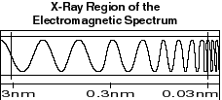
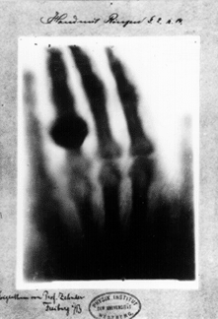
The Electromagnetic Spectrum, continued
X Rays
X rays can’t penetrate our atmosphere so X ray telescopes must be located in space
X ray images
Have YOU ever needed x rays?

Slide 42
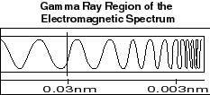
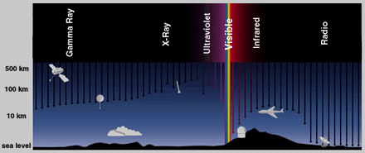
The Electromagnetic Spectrum, continued
Gamma rays
Most energetic, shortest wavelength, highest frequency
Nuclear reactions, decay
Produced in space
Supernova explosions – massive star explosion
Neutron stars and pulsars – collapsed star at end of life cycle
Black holes – end of massive star’s life cycle, super dense, high gravitational

Slide 44
Electromagnetic Spectrum – Wavelength, Frequency and Energy
LOWEST ENERGY
HIGHEST ENERGY
LONGEST (HIGHEST) WAVELENGTH
SHORTEST (LOWEST)
WAVELENGTH
LOWEST FREQUENCY
HIGHEST FREQUENCY

Slide 45
Energy waves → Other forms of E
Sun light is EM radiation (mixture of UV, infrared, visible light)
How does the metal part of a seatbelt feel in the summer on a hot day?
Why?
How is this an example of waves changing into other forms of energy?

Slide 46
Warm-Up

Slide 47
The Behavior of Waves
Reflection
Reflection is the bouncing back of a wave when it meets a surface or boundary
At a free boundary, the reflected wave is exactly like the original wave except that it is travelling in opposite direction (PICTURE)
At fixed boundary, wave follows Newton’s 3rd law and is thus reflect back upside down (still travelling in opposite direction) (PICTURE)
The Law of Reflection
States that the angle at which the incident beam (original) strikes a surface is equal to the angle of the reflected beam (PICTURE) (NEXT)

Slide 48
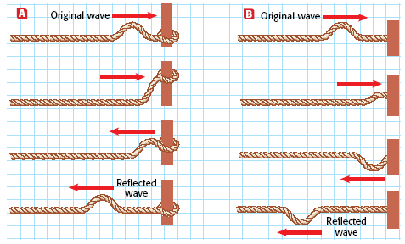
Reflection – Free Boundary
BACK

Slide 49
Reflection – Fixed Boundary
BACK

Slide 50
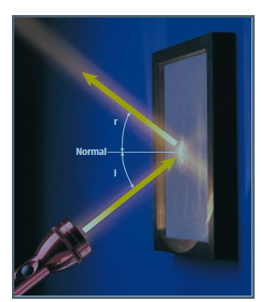
Law of Reflection
Light
Sound
BACK

Slide 51
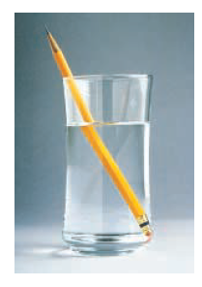
The Behavior of Waves, continued
Refraction
Refraction is the bending of a wave as the speed of the wave changes as it moves from one medium to another Refraction is always accompanied by wavelength and speed change.
Other examples: spearfishing, rainbows (prism/atmosphere), glasses

Slide 52
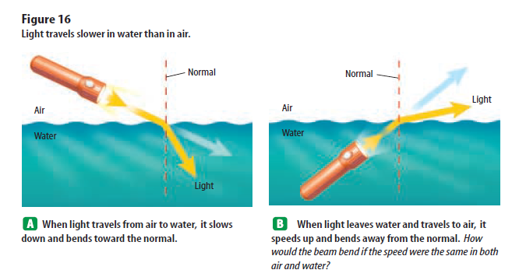
Refraction – change in speed

Slide 53
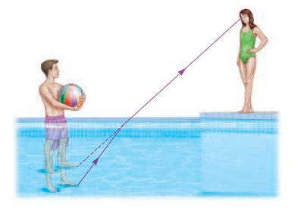
The Behavior of Waves, continued
Refraction
Underwater, objects seems closer to the surface than they really are
Your brain assumes that all light waves have traveled in a straight line
This makes it appear that the light waves coming from an object underwater came from a higher point

Slide 54
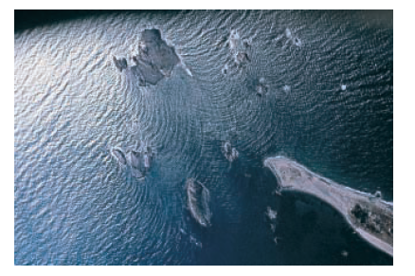
The Behavior of Waves, continued
Diffraction
Diffraction occurs when an object causes a wave to change direction and bend around it
The amount of diffraction depends on how big the obstacle or opening is compared to the wavelength

Slide 55
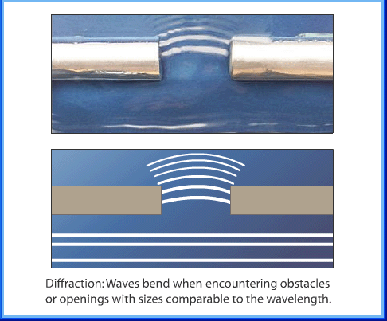
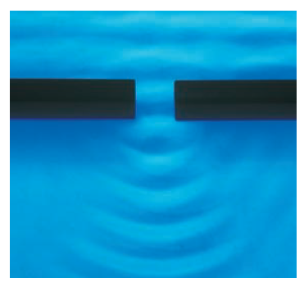
Diffraction – an opening

Slide 56
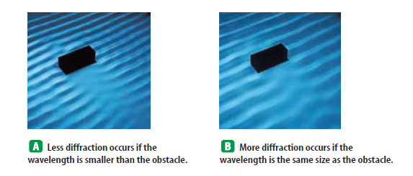
Diffraction – an obstacle

Slide 57
Diffraction Examples
Tweets of songbirds vs. Hoots of Owls
Tweets have shorter wavelengths, so they don’t diffract as much, while hoots have longer wavelengths, so they diffract more!
Diffraction is what allows you to hear conversations down the hallway and around the corner in the cafeteria.
Spectrometers use diffraction (and interference) of light from slits or gratings to separate wavelengths. Faint peaks of E at specific wavelengths can be detected and recorded. A graph of these is called a spectral signature. Patterns in a spectral sig help scientists identify the physical condition and composition of stellar and interstellar matter. (temperature and composition).

Slide 58
The Behavior of Waves, continued
Interference
Interference is the process of combining two or more waves into a new wave
Constructive interference is any interference in which waves add together
The resulting wave is bigger than the original waves (PICTURE)
Destructive interference is any interference in which waves subtract from each other
The resulting wave is smaller than the largest of the original waves (PICTURE)
Waves may even completely cancel each other out (PICTURE) (NEXT)

Slide 59
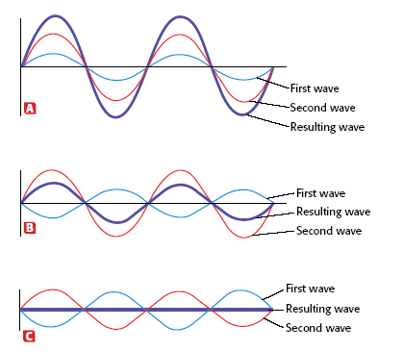
Interference - Constructive
Constructive Interference
Destructive Interference
Destructive Interference
BACK

Slide 60
Interference – Destructive (semi)
Constructive Interference
Destructive Interference
Destructive Interference
BACK

Slide 61
Interference – Destructive (complete)
Constructive Interference
Destructive Interference
Destructive Interference
BACK

Slide 62
Applications
Reflection – water waves, light waves, sound waves
Refraction – deep to shallow water waves, broken pencil, spear fishing
Diffraction – owl hoots vs songbird tweets, light around particles in air
Constructive Interference – concert hall, stereo speakers, amplifiers
Destructive Interference – car muffler, noise cancelling headphones

Slide 63
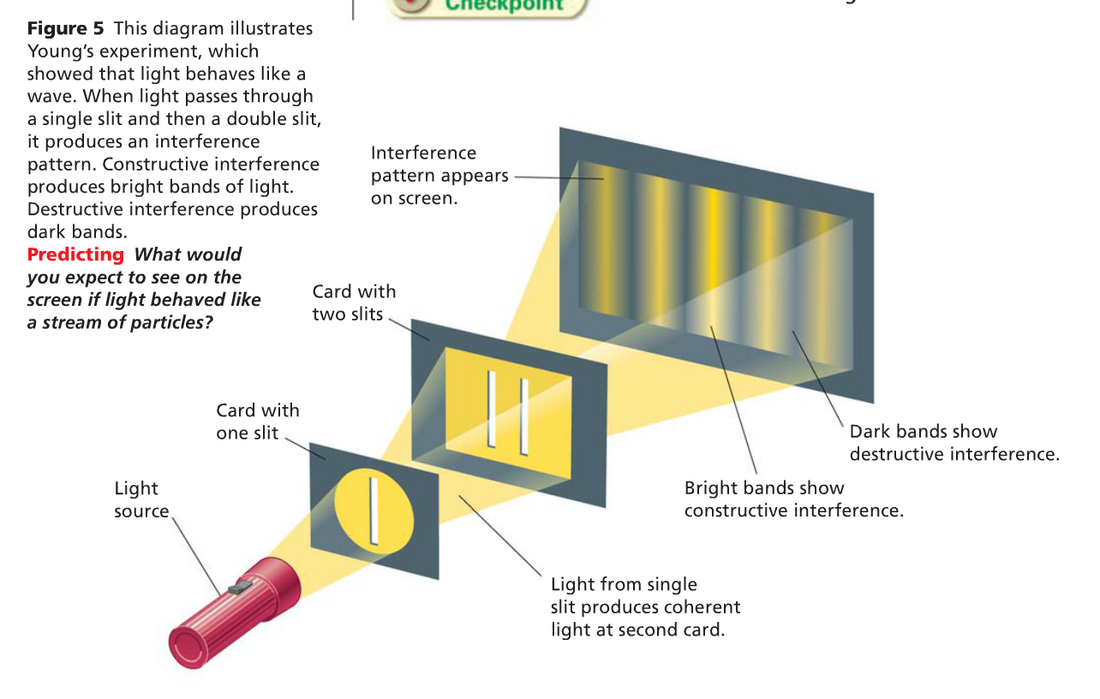
Is light a wave? (2:15-7, 8:24-end)

Slide 64
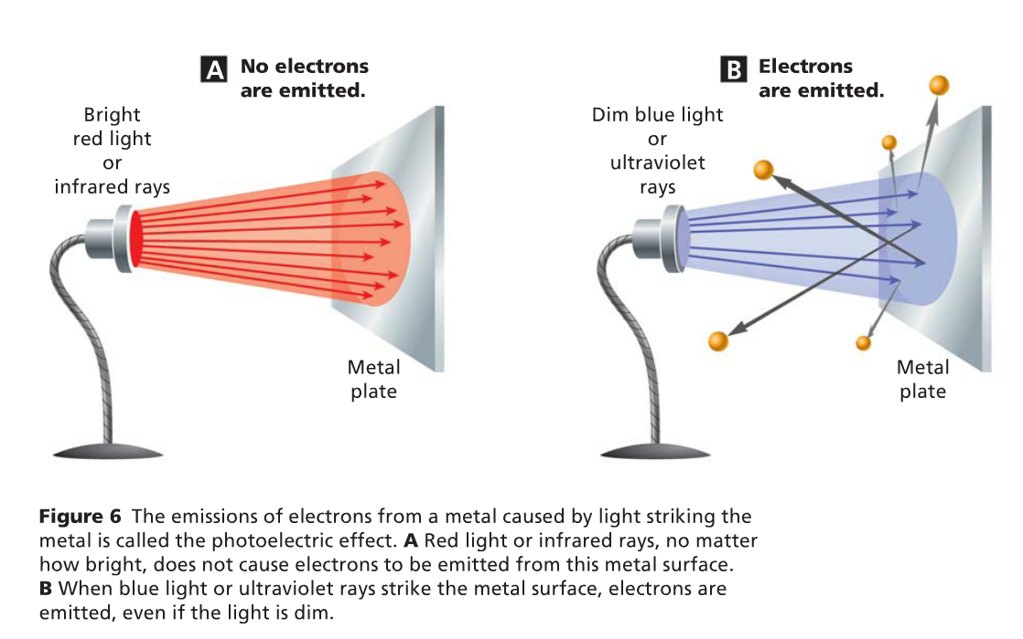
Is light a particle? (start @ 4)

Slide 65
Pg 512: 1-8
1. How is a wave changed by reflection? The reflected wave is upside down compared to the original wave. (if a fixed end)
2. What causes refraction when a wave enters a medium at an angle? The wave changes speed as it enters a new medium, resulting in the change of direction.
3. What determines how much a wave diffracts when it encounters an opening or obstacle? The larger the wavelength compared to the obstacle or opening, the more the wave diffracts.
4. List the types of interference. Constructive, destructive
5. At what wavelength can a standing wave form in an elastic cord? Only if half a wavelength or a multiple of half a wavelength fits exactly into the length of the vibrating object.
6. How does the frequency of a reflected wave compare to the frequency of an incoming wave? The are equal.
7. How are diffraction and refraction similar? Different? Both involve the bending of waves. R occurs because the medium changes, and D occurs when a wave encounters an obstacle or a narrow opening.
8. What is the amplitude of the wave that results when two identical waves interfere constructively? Double the amplitude

Slide 66
The Behavior of Waves, continued
Standing Waves
A standing wave is a pattern of vibration that simulates a wave that is standing still
Waves equal in wavelength and amplitude, but travelling in opposite directions
Where wave cancel out (complete destructive interference) are called nodes
Midway between the nodes lie points of maximum vibration, called antinodes
constructive interference

Slide 67
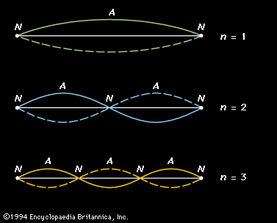
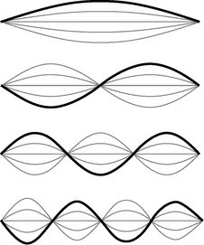
Standing Waves

